Slide 1
Subqueries in SQL
Mary, Sanchit, Andrew

Slide 2
DESCRIPTION
Subqueries(also know as inner queries or nested queries) are a tool for performing operations in multiple steps. For example, if you wanted to take the sums of several columns, then average all those values, you’d need to do each aggregation in a distinct step.
or
A subquery is a query that is nested inside a SELECT, INSERT, UPDATE, or DELETE statement or inside another subquery. A subquery can return a set of rows or just one row to its parent query. A scalar subquery is a query that returns exactly one value: a single row, with a single column. Scalar subqueries can be used in most places in a SQL statement where you could use an expression or a literal value.
http://searchoracle.techtarget.com/feature/Define-SQL-subqueries
https://community.modeanalytics.com/sql/tutorial/sql-subqueries/

Slide 3
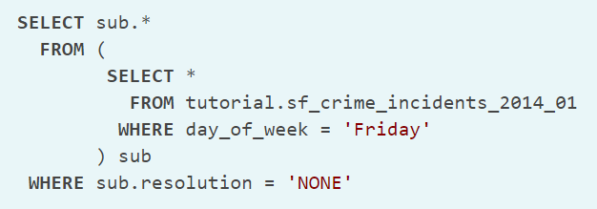
HOW IT MIGHT BE USED
- Can be used in multiple places in a query but easiest to start with the FROM statement:

Slide 4
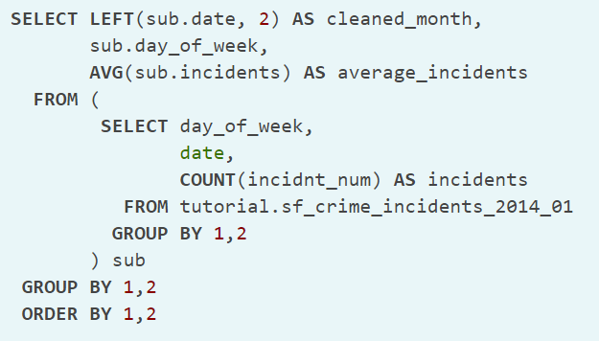
HOW IT MIGHT BE USED
- Can be used to aggregate in multiple stages:

Slide 5
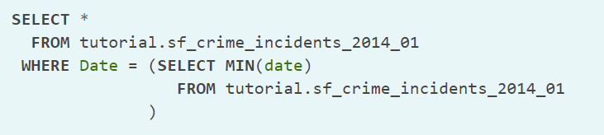
HOW IT MIGHT BE USED
- Can be used in conditional logic:

Slide 6
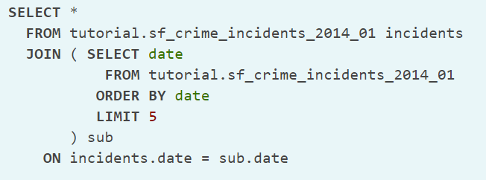
HOW IT MIGHT BE USED
- Can be used to join the same table with itself:

Slide 7
EXAMPLE WITH LIBRARY DB

